Slide 1
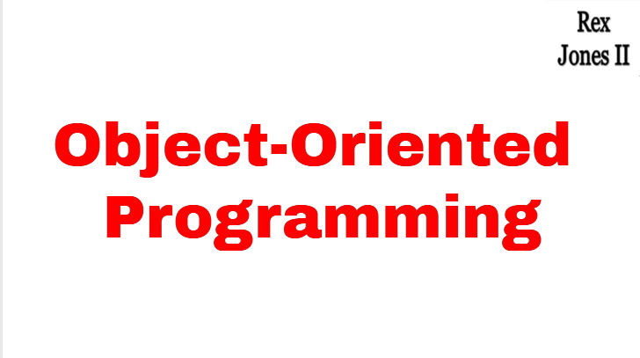

Slide 2
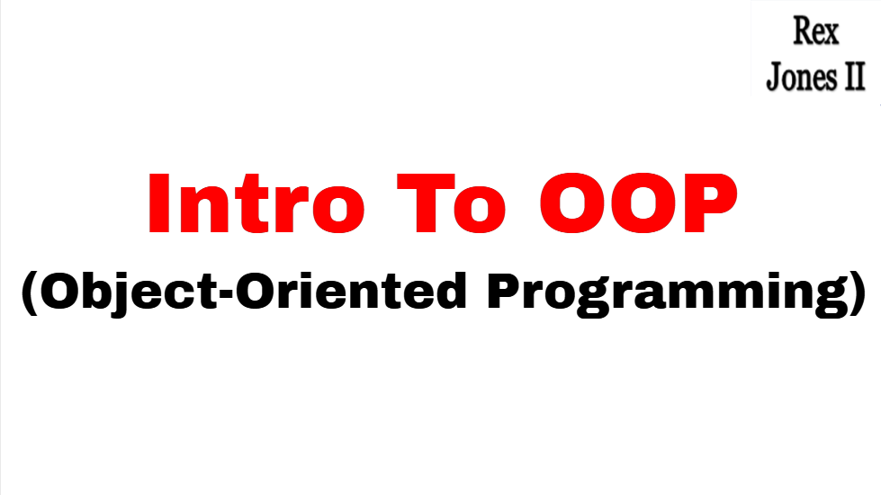

Slide 3
Structured Programming
An Employee works at a company
calculateSalary {
// Calculate Salary
_______________ _______________
}
Submit Resume
Attend Interview(s)
Get Hired At Company
Perform Job Responsibilities
Receive Paycheck From Company
calculateBonus {
// Calculate Bonus
_______________ _______________
}
calculateHealthBenefits {
// Calculate Health Benefits
_______________ _______________
}

Slide 4
Object-Oriented Programming
An Employee works at a company
class Employee {
int age;
int employeeID;
String title;
calculateSalary {
// Calculate Salary
_______________ _______________
}
calculateBonus {
// Calculate Bonus
_______________ _______________
}
}
Submit Resume
Attend Interview(s)
Get Hired At Company
Perform Job Responsibilities
Receive Paycheck From Company

Slide 5




OOP vs Structured
Structured Programming
Object-Oriented Programming
calculateSalary {
// Calculate Salary
_______________ _______________
}
class Employee {
int age;
int employeeID;
String title;
calculateSalary {
// Calculate Salary
_______________ _______________
}
calculateBonus {
// Calculate Bonus
_______________ _______________
}
}
calculateBonus {
// Calculate Bonus
_______________ _______________
}
calculateHealthBenefits {
// Calculate Health Benefits
_______________ _______________
}

Slide 6
Classes & Objects
Employee jane, john;
jane.age = 25;
jane.employeeID = 34;
jane.title = “Automation Engineer”;
jane.calculateSalary();
jane.calculateBonus();
john.age = 55;
john.employeeID = 99;
john.title = “Automation Engineer”;
john.calculateSalary();
john.calculateBonus();
class Employee {
int age;
int employeeID;
String title;
calculateSalary {
// Calculate Salary
_______________ _______________
}
calculateBonus {
// Calculate Bonus
_______________ _______________
}
}

Slide 7
Video Tutorial Series
Encapsulation
Inheritance
Polymorphism
Method Overload
Method Override
Abstraction
Abstract Classes
Abstract Methods
Interfaces

Slide 8
Video Tutorial Series
Encapsulation
Inheritance
Abstract Classes
Abstract Methods
Interfaces
Polymorphism
Method Overload
Method Override

Slide 9
Video Tutorial Series
Encapsulation
Inheritance
Polymorphism
Abstraction

Slide 10
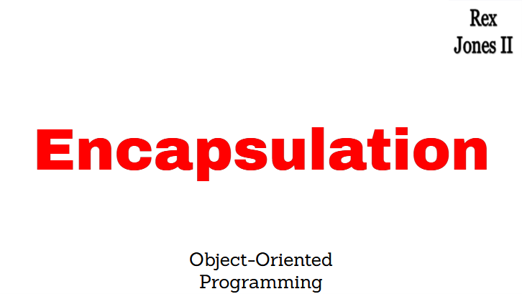

Slide 11
Video Tutorial Series
Encapsulation
Inheritance
Polymorphism
Abstraction

Slide 12
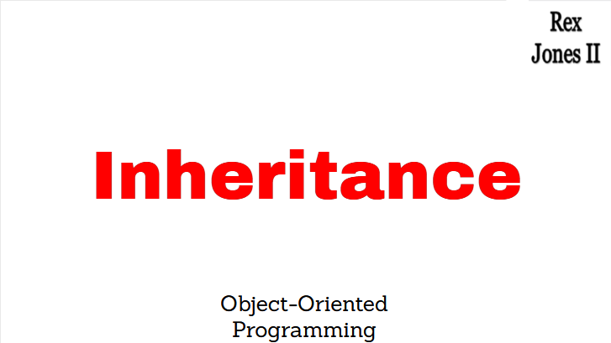

Slide 13
Video Tutorial Series
Encapsulation
Inheritance
Polymorphism
Abstraction

Slide 14
Inheritance
Person
Employee

Slide 15
Inheritance
Person
Employee
Student
Manager
Team Lead
Graduate
Under Graduate

Slide 16
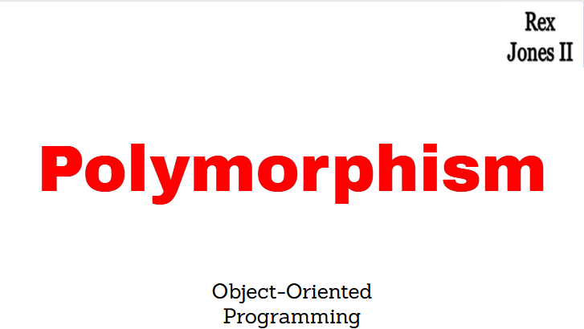

Slide 17
Video Tutorial Series
Encapsulation
Inheritance
Polymorphism
Abstraction

Slide 18
Inheritance
Person
Employee
Student
Manager
Team Lead
Graduate
Under Graduate

Slide 19
Polymorphism
Method Overloading
Method Overriding
Java Bindings
Static Binding
Dynamic Binding

Slide 20
Polymorphism
Method Overloading
Method Overriding
Java Bindings
Static Binding
Dynamic Binding

Slide 21
Polymorphism
Method Overloading
Method Overriding
Java Bindings
Static Binding
Dynamic Binding

Slide 22
Inheritance
Person
Employee
Student
Manager
Team Lead
Graduate
Under Graduate

Slide 23
Polymorphism
Method Overloading
Method Overriding
Java Bindings
Static Binding
Dynamic Binding

Slide 24
Inheritance
Person
Employee
Student
Manager
Team Lead
Graduate
Under Graduate

Slide 25
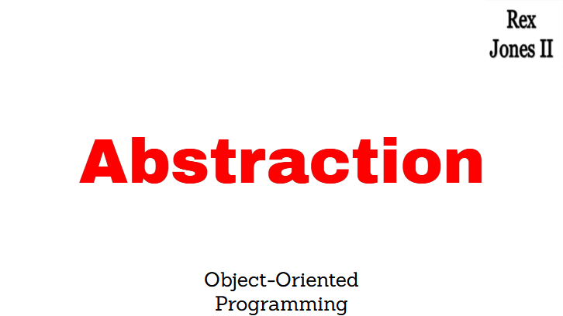

Slide 26
Video Tutorial Series
Encapsulation
Inheritance
Polymorphism
Abstraction

Slide 27
Abstraction Example
public abstract class Cat {
private String breed;
abstract void meow ();
}

Slide 28
Abstraction Example
public abstract class Cat {
private String breed;
abstract void meow ();
}

Slide 29
Abstraction
Abstract Classes
Abstract Methods

Slide 30
Abstraction Example
public abstract class Cat {
private String breed;
abstract void meow ();
}

Slide 31
Abstraction
Abstract Classes
Abstract Methods
Interfaces

Slide 32
Abstraction
Abstract Classes
Abstract Methods
Interfaces

Slide 33
Abstraction Shape Example
Square
Rectangle
side
length
side
side
width
width
side
length
Perimeter = 4 * side
Perimeter = (2 * length) + (2 * width)

Slide 34
Abstraction
Abstract Classes
Abstract Methods
Interfaces

Slide 35
Interface Syntax
public interface Day {
int HOURS_IN_A_DAY = 24;
void calculateHours ();
}

Slide 36
Interface Benefits
Consistency For All Implementation Classes
Support of Multiple Implementation

Slide 37
Interface Benefits
Consistency For All Implementation Classes
Support of Multiple Implementation

Slide 38
Interface Benefits
Consistency For All Implementation Classes
Support of Multiple Implementation

Slide 39
Inheritance
Super Class
Sub Class 1
Sub Class 2
Sub Class 3

Slide 40
Inheritance
Store
Food Store
Clothes Store
Medicine Store

Slide 41
Inheritance Diamond Problem
Store
Food Store
Clothes Store
Medicine Store
Combo Store

Slide 42
Multiple Interface
Implementation
Store
Food Store
Clothes Store
Medicine Store
Combo Store

Slide 43
Extend Multiple Interfaces
public interface Day extends Week, Month {
int HOURS_IN_A_DAY = 24;
void calculateHours ();
}

Slide 44
Video Tutorial Series
Encapsulation
Inheritance
Polymorphism
Abstraction

